Slide 1
Food-Environment-Effect-On-Obesity
Presented by Jyoti Shukla

Slide 2
Obesity
Obesity is a complex disease involving an excessive amount of body fat. Obesity isn't just a cosmetic concern. It is a medical problem that increases your risk of other diseases and health problems, such as heart disease, diabetes, high blood pressure and certain cancers. Everybody knows about human risk factors such as diet, physical activity, inactivity, drug use, and genetics.
Many key factors in our society include education, skills, food marketing, affordability of healthy foods, physical activity, and food environment.
The food environment plays a major and frequently dominant role in nutrition choice, eating habits, and eventually energy intake.
Through this project, I have analyzed the impact of food environments on adult obesity rates the same is going to present to the County Officials / State Governors some actionable insights.

Slide 3
Data Source and understand data
I have used 2014 data from USDA (United States Department of Agriculture, Economic Research Service) Food Atlas [https://www.ers.usda.gov/data-products/food-environment-atlas/data-access-and-documentation-downloads/#February%202014%20Version].
It is a public dataset containing data for 3179 US counties. It has 212 different variable names from different categories like Health, Insecurity, local, restaurants, stores, socio-economic data of each county. It also provides some Supplemental data like population, meal programs in the USDA dataset. The data is in the form of a single excel file with data sorted in multiple sheets as per the category
For this project, I have used the Food Environment Atlas Data: FoodEnvironmentAtlas2014.xls file
For Data Analysis and Visualization I have used some variables from the list, which are described in the Variable and constraints section.

Slide 4
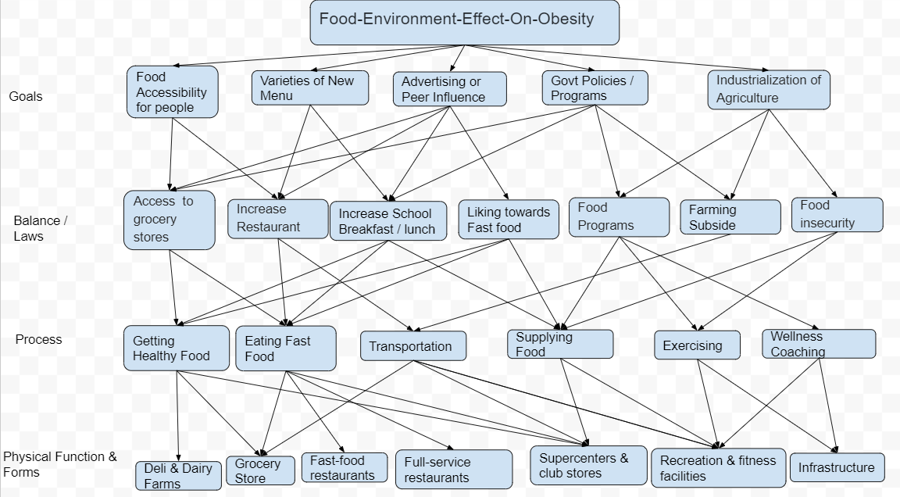
Work Domain Analysis

Slide 5
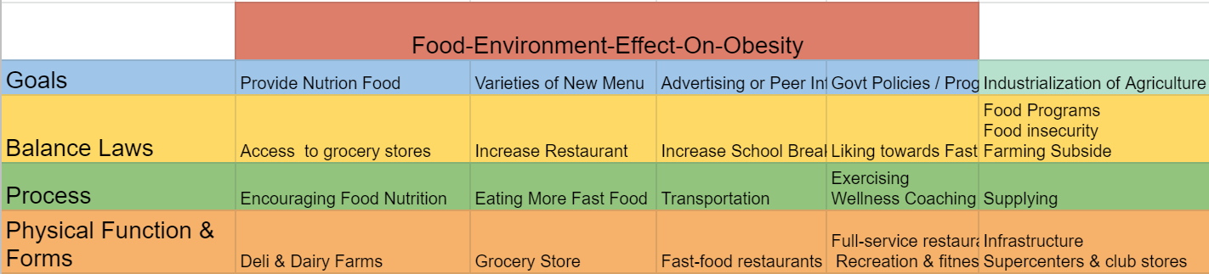
Part-Whole Decomposition

Slide 6
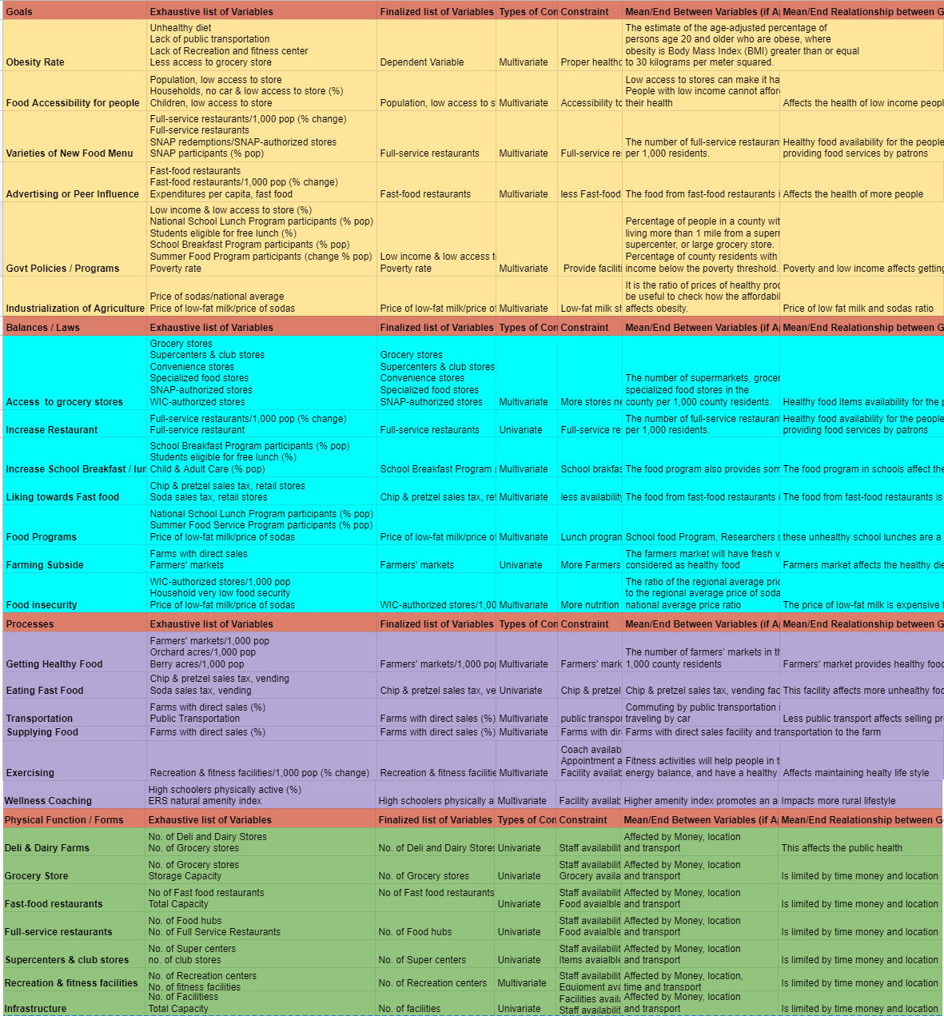
Variables & Constraints

Slide 7
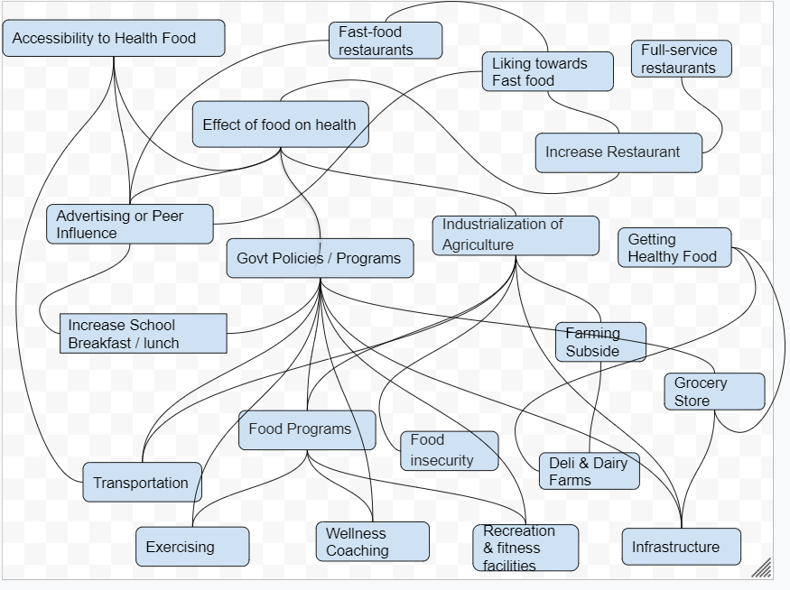
Abstraction Network

Slide 8
Data Visualization
I have merged sociodemographic, restaurants, food stores, and obesity data from the Food Environment Atlas Data to show the frames of reference how the obesity over the total population and the the main reasons are mostly poverty, less healthy food access choice, more fast food consumption and less access to recreation and fitness centers..
From the Visualization it shows the active lifestyle, healthier food environment and choices are significant in controlling obesity and diabetes both..
For visualization i have used scatter plot, bar graph and dual axis graph to represent the required data. I have chosen the below frames as they shows how the poverty, and less nutrition food impacts people's’ health.

Slide 9
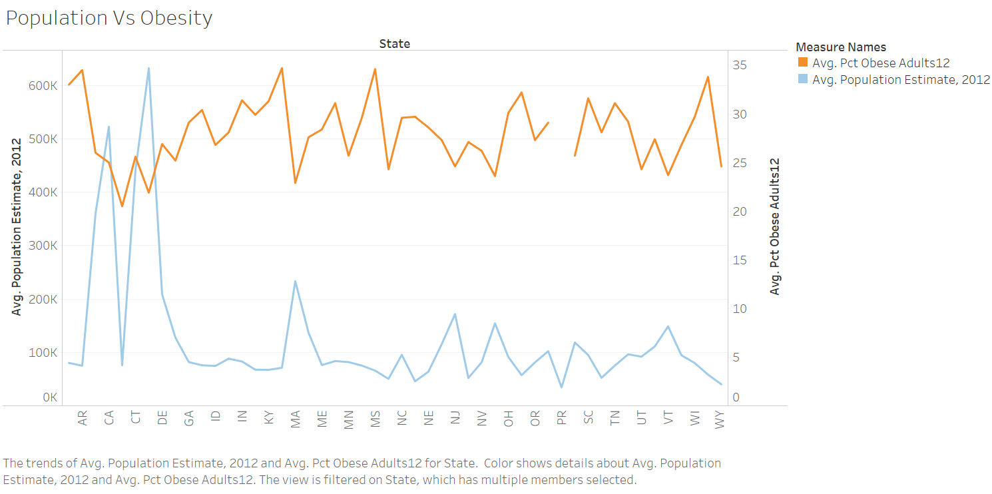
Frames of reference

Slide 10
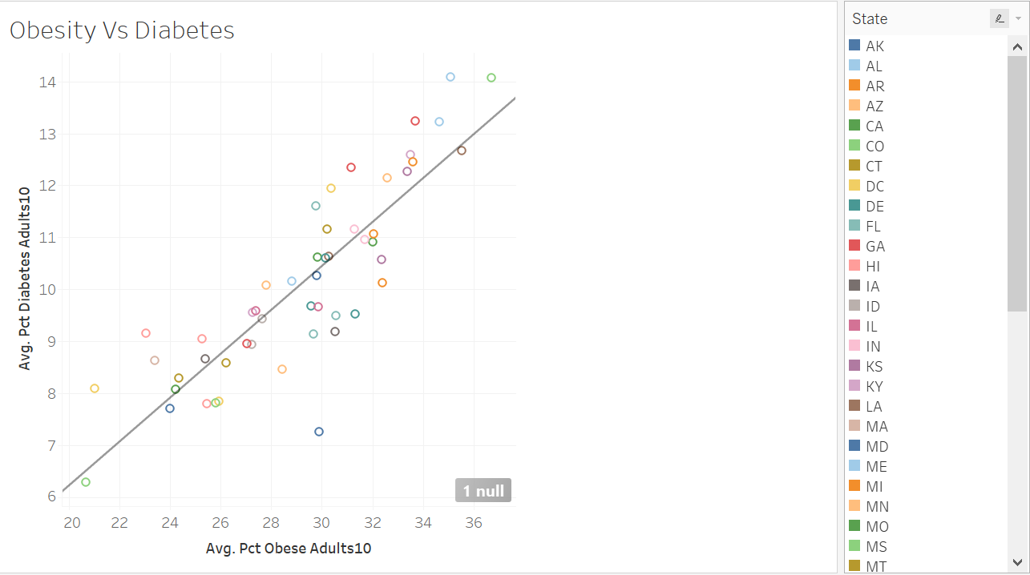

Slide 11
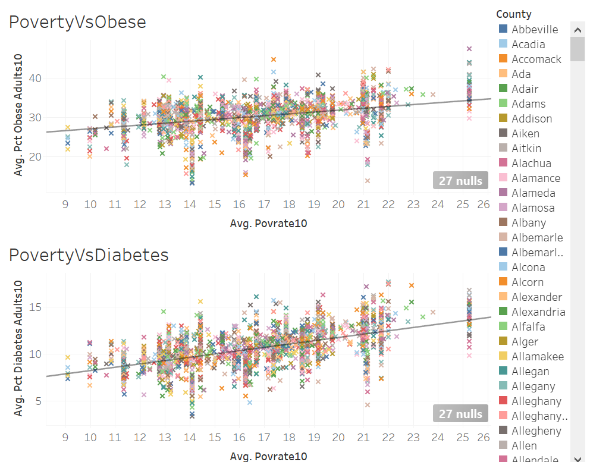

Slide 12
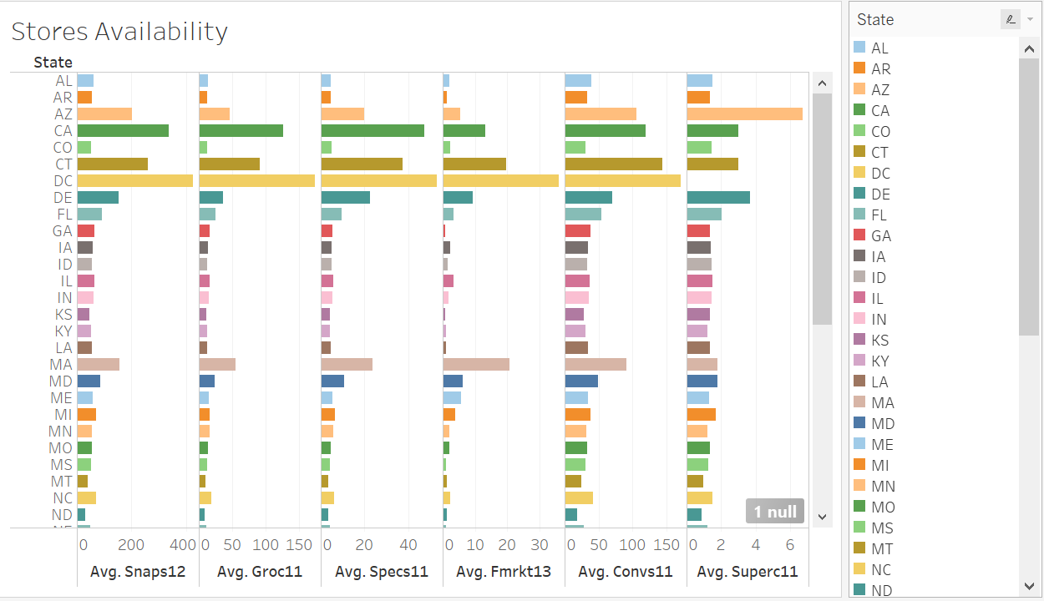

Slide 13
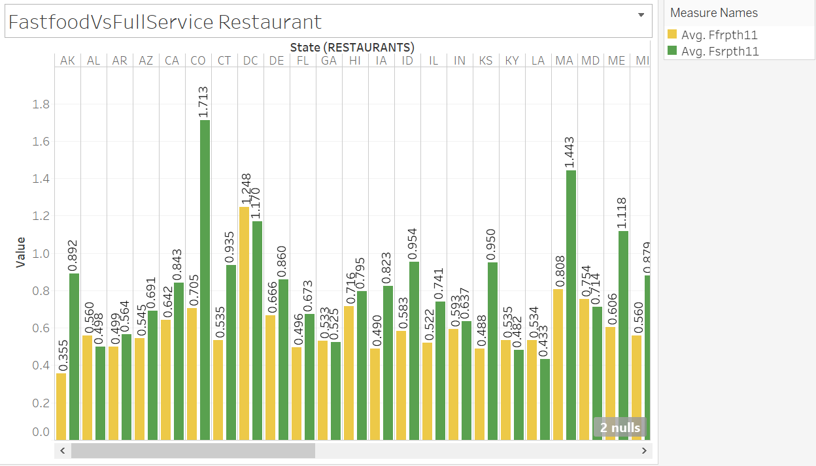

Slide 14
What factor or factors are contributing to obesity and diabetes in America?
Recreational facilities promote healthy and active living and can help to reduce obesity
Full-service restaurants are a healthier alternative to fast food restaurants as they provide well cooked nutritious, low-calorie healthy food.
The affordability of healthy food items has a great impact on controlling obesity. If the prices are 1% less expensive compared to unhealthy products like soda, obesity can be reduced
Reducing Poverty also helps to control obesity as the low income people try to but food which is less pricy and these are not healthy
Specialized food stores like retail bakeries, meat and seafood markets, dairy stores, and produce markets are popular and often visited by people. Obesity can be reduced if the number of specialized stores per 1000 population increase
If more people travel to work by public transportation, obesity can be controlled
Finally Education helps to create more awareness about the importance of healthy and active living and can help to reduce obesity.

Slide 15
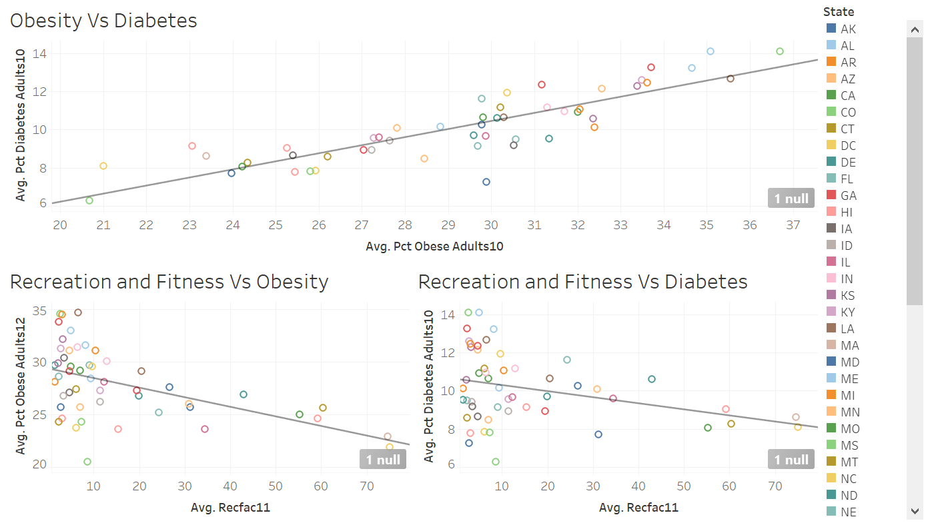
Recreational and Fitness facilities helps to reduce obesity

Slide 16
What factor or factors contained in the dataset DO NOT seem to contributing to one or both of these health issues?
Low accessibility to stores is a hurdle for having access to healthy food, it does not have any effect on obesity and diabetes. I observed in the visualization low accessibility to store is not really impacting obesity. The same scatter plot graph is shown in the next slide.

Slide 17
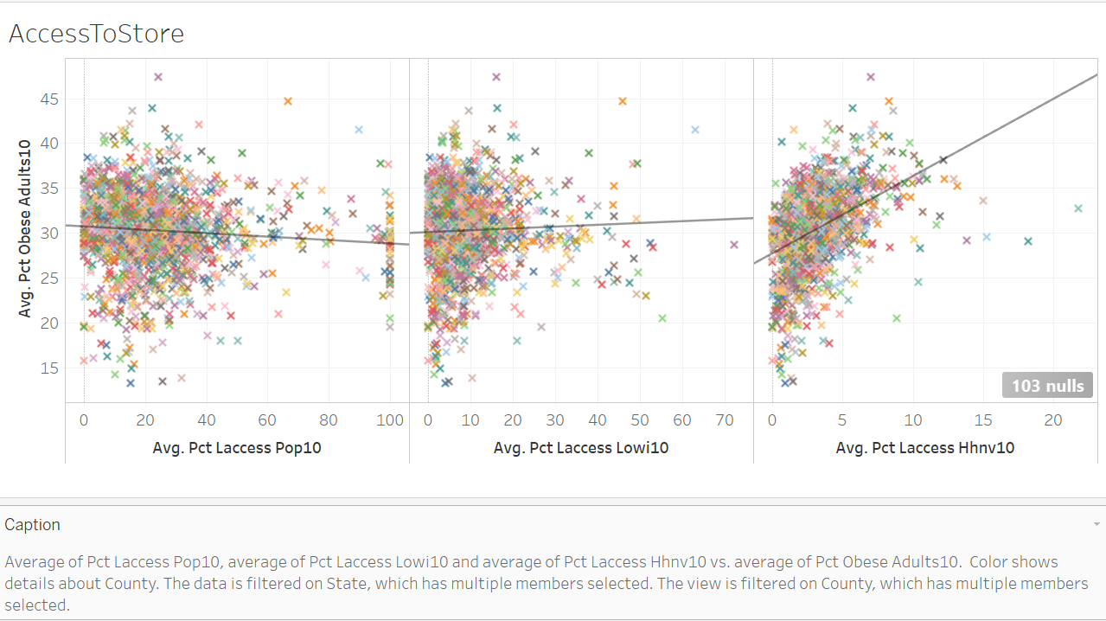

Slide 18
Recommendation to County Officials or State Govt:
Make healthy food products more affordable with the help of food assistance programs like SNAP(S) (Supplemental Nutrition Assistance Program). Increase of taxes on unhealthy products and subsidies for healthy ones can also help.
Open more recreational facilities for every 1000 population to promote active living.
Open more healthy food outlets like full-service restaurants and specialized stores (retail bakeries, meat and seafood markets, dairy stores, and produce markets) for every 1000 population.
Control the number of supermarkets and club stores per 1000 population. They make food products like soda, instant and processed food, more convenient and readily available. It increases obesity risk.
Grocery store Vs Convenience store food quality is a characteristic of the food environment that has been found to vary by store type, with convenience stores generally selling fresh produce of lower quality than grocery stores which impacts health.
My analysis suggests that active lifestyle, healthier food environment and choices are significant in controlling obesity

Slide 19
Strategies to Prevent Obesity
There is no single or simple solution to the obesity epidemic.
It’s a complex problem and there has to be a multifaceted approach.
Policy makers, state and local organizations, business and community leaders, school, childcare and healthcare professionals, and individuals must work together to create an environment that supports a healthy lifestyle.
There are several ways state and local organizations can create a supportive environment to promote healthy living behaviors that prevent obesity as I described in the Recommendation to County officials and State Govt slide..

Slide 20
Reference:
https://www.ers.usda.gov/data-products/food-environment-atlas/
https://www.ncbi.nlm.nih.gov/pmc/articles/PMC4287570/
https://www.ncbi.nlm.nih.gov/pmc/articles/PMC2708156/
https://www.cdc.gov/obesity/strategies/index.html

Slide 21
Thank you so much!

